Slide 1
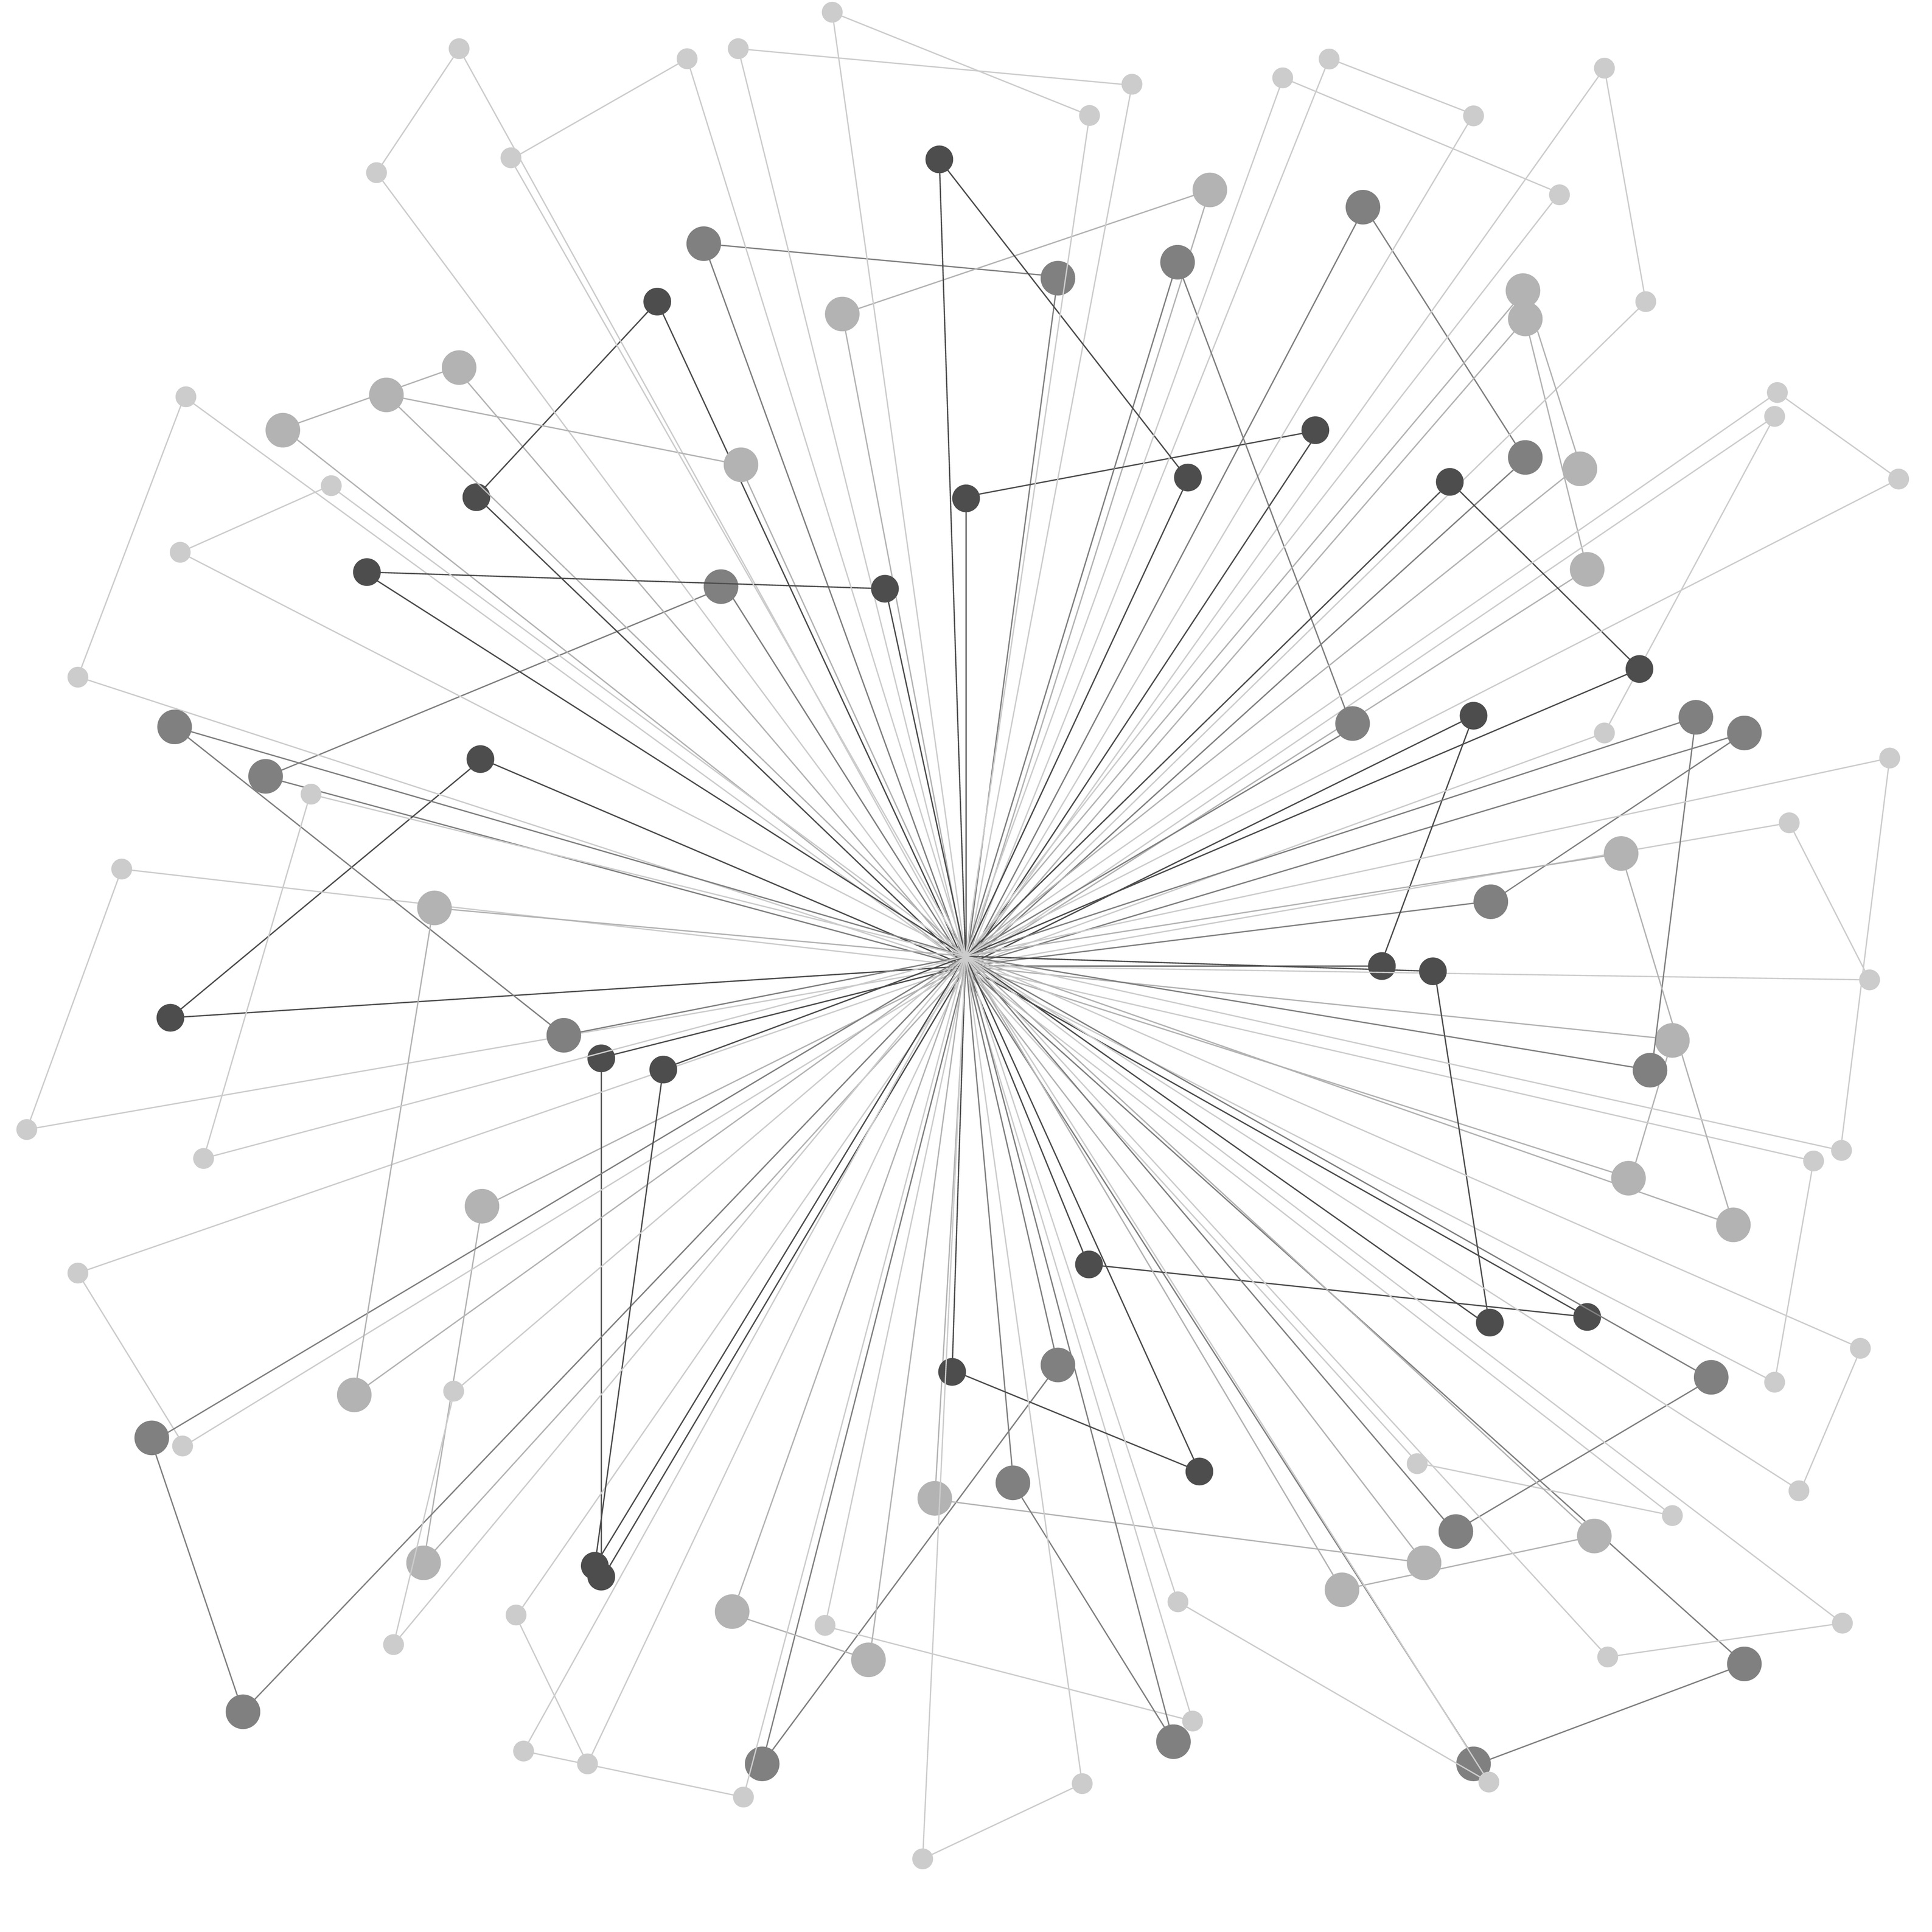
July 21, 2025
Internal Network Penetration Test
for Sample Client
Demo Consultant
support@vpentest.io
Notes:
Presenter Notes

Slide 2
SCOPE OF WORK
Internal Network Penetration Test
This assessment attempted to identify security threats that are exposed on the internal network environment. Threats identified within the internal environment are usually less severe than those of the external environment due to the limited exposure.
Notes:
An internal network penetration test was conducted to identify security threats within the internal network environment. The purpose of this assessment was to identify vulnerabilities and demonstrate real-world impact. The assessment took place from June 27, 2025, to July 21, 2025. A total of 256 systems were targeted, with 24 systems found during the evaluation. Ultimately, 12 findings were noted, highlighting key areas of concern. The upcoming slide deck will outline these key priorities and suggested remediation paths.

Slide 3

HIGH LEVEL OVERVIEW OF FINDINGS
DISCOVERED THREATS | THREAT SEVERITY RANKINGS | THREAT SEVERITY RANKINGS
IPv6 DNS Spoofing |  | Critical
Link-Local Multicast Name Resolution (LLMNR) Spoofing |  | Critical
Microsoft Windows RCE (EternalBlue) |  | Critical
Notes:
Presenter Notes

Slide 4

PENTEST FINDING
CRITICAL
IPv6 DNS Spoofing
Observation
Recommendation
The organization faces a risk from potential attacks that could disrupt its network operations by misleading devices and redirecting them to malicious servers. This could result in compromised security and loss of sensitive information.
This vulnerability could allow an attacker to intercept and redirect sensitive data, including user credentials, which may lead to significant data breaches and compromise the organization's operational integrity.
The organization should evaluate and implement measures to manage unauthorized DHCP activity, while considering preferring IPv4 over IPv6 to enhance overall DNS security and reduce vulnerability to spoofing attacks.
Notes:
A vulnerability has been identified that allows for IPv6 DNS spoofing through rogue DHCPv6 servers within the network.
This issue could be exploited by attackers to redirect users to malicious websites, leading to data breaches or significant disruptions to business operations. The use of unauthorized DHCP servers could allow attackers to gain control over network communications.
Immediate remediation is necessary, which can typically be implemented within a few days if properly planned and executed.

Slide 5
PENTEST FINDING
CRITICAL
IPv6 DNS Spoofing
Evidence
IPv6 address fe80::4292:1 is now assigned to mac=bc:24:11:1d:f9:19 host=vpentest. ipv4=
IPv6 address fe80::4292:2 is now assigned to mac=bc:24:11:b8:98:06 host=vpentest. ipv4=
IPv6 address fe80::4292:3 is now assigned to mac=bc:24:11:f0:ef:b7 host=vpentest. ipv4=
IPv6 address fe80::4292:4 is now assigned to mac=bc:24:11:d9:2a:c2 host=vpentest. ipv4=
IPv6 address fe80::4292:5 is now assigned to mac=bc:24:11:2e:f0:d2 host=willvpentest. ipv4=
IPv6 address fe80::4292:6 is now assigned to mac=bc:24:11:6d:ed:ec host=utopos. ipv4=
IPv6 address fe80::4292:7 is now assigned to mac=bc:24:11:93:6d:20 host=vpentest. ipv4=
IPv6 address fe80::4292:5 is now assigned to mac=bc:24:11:2e:f0:d2 host=willvpentest. ipv4=
IPv6 address fe80::4292:1 is now assigned to mac=bc:24:11:1d:f9:19 host=vpentest. ipv4=
IPv6 address fe80::4292:7 is now assigned to mac=bc:24:11:93:6d:20 host=vpentest. ipv4=
IPv6 address fe80::4292:6 is now assigned to mac=bc:24:11:6d:ed:ec host=utopos. ipv4=
IPv6 address fe80::4292:5 is now assigned to mac=bc:24:11:2e:f0:d2 host=willvpentest. ipv4=
IPv6 address fe80::4292:7 is now assigned to mac=bc:24:11:93:6d:20 host=vpentest. ipv4=
IPv6 address fe80::4292:6 is now assigned to mac=bc:24:11:6d:ed:ec host=utopos. ipv4=
IPv6 address fe80::4292:1 is now assigned to mac=bc:24:11:1d:f9:19 host=vpentest. ipv4=
IPv6 address fe80::4292:5 is now assigned to mac=bc:24:11:2e:f0:d2 host=willvpentest. ipv4=
IPv6 address fe80::4292:7 is now assigned to mac=bc:24:11:93:6d:20 host=vpentest. ipv4=
IPv6 address fe80::4292:6 is now assigned to mac=bc:24:11:6d:ed:ec host=utopos. ipv4=
IPv6 address fe80::4292:1 is now assigned to mac=bc:24:11:1d:f9:19 host=vpentest. ipv4=
IPv6 address fe80::4292:5 is now assigned to mac=bc:24:11:2e:f0:d2 host=willvpentest. ipv4=
IPv6 address fe80::4292:7 is now assigned to mac=bc:24:11:93:6d:20 host=vpentest. ipv4=
--snipped--
Notes:
Presenter Notes

Slide 6
PENTEST FINDING
CRITICAL
Link-Local Multicast Name Resolution (LLMNR) Spoofing
Observation
Recommendation
This vulnerability allows attackers to exploit the name resolution process within the organization's internal network, potentially leading to unauthorized access to sensitive information. If unaddressed, it could compromise the security posture and data integrity of the organization.
If exploited, an attacker could falsely direct users to their own systems, potentially compromising sensitive data and leading to unauthorized access to critical organizational resources.
The organization should implement policies to disable Link-Local Multicast Name Resolution (LLMNR) to enhance network security and prevent potential exploitation.
Notes:
A vulnerability was identified in the Link-Local Multicast Name Resolution (LLMNR) protocol used for DNS name resolution within internal networks.
This issue could be exploited by attackers to masquerade as other systems, allowing them to capture sensitive data or redirect communications, significantly undermining network security. The potential for unauthorized access to critical systems poses a severe business risk.
Immediate remediation is recommended, typically achievable within a few hours by disabling LLMNR through registry configurations or Group Policy settings.

Slide 7
PENTEST FINDING
CRITICAL
Link-Local Multicast Name Resolution (LLMNR) Spoofing
Evidence
2025-07-08 17:21:08,219 - [*] [LLMNR] Poisoned answer sent to fe80::4dda:3091:4ca7:f5d for name Bravos
2025-07-08 17:21:08,220 - [*] [LLMNR] Poisoned answer sent to 192.168.2.11 for name Bravos
2025-07-08 17:21:08,221 - [*] [LLMNR] Poisoned answer sent to fe80::4dda:3091:4ca7:f5d for name Bravos
2025-07-08 17:21:08,224 - [*] [LLMNR] Poisoned answer sent to 192.168.2.11 for name Bravos
2025-07-08 17:21:08,237 - [*] [LLMNR] Poisoned answer sent to fe80::4dda:3091:4ca7:f5d for name Bravos
2025-07-08 17:21:08,237 - [*] [LLMNR] Poisoned answer sent to 192.168.2.11 for name Bravos
2025-07-08 17:21:08,240 - [*] [LLMNR] Poisoned answer sent to 192.168.2.11 for name Bravos
2025-07-08 17:21:08,238 - [*] [LLMNR] Poisoned answer sent to fe80::4dda:3091:4ca7:f5d for name Bravos
2025-07-08 17:21:08,259 - [*] [LLMNR] Poisoned answer sent to 192.168.2.11 for name Bravos
2025-07-08 17:21:08,259 - [*] [LLMNR] Poisoned answer sent to fe80::4dda:3091:4ca7:f5d for name Bravos
2025-07-08 17:21:08,261 - [*] [LLMNR] Poisoned answer sent to fe80::4dda:3091:4ca7:f5d for name Bravos
2025-07-08 17:21:08,262 - [*] [LLMNR] Poisoned answer sent to 192.168.2.11 for name Bravos
2025-07-08 17:21:08,276 - [*] [LLMNR] Poisoned answer sent to fe80::4dda:3091:4ca7:f5d for name Bravos
2025-07-08 17:21:08,277 - [*] [LLMNR] Poisoned answer sent to fe80::4dda:3091:4ca7:f5d for name Bravos
2025-07-08 17:21:08,279 - [*] [LLMNR] Poisoned answer sent to 192.168.2.11 for name Bravos
2025-07-08 17:21:08,279 - [*] [LLMNR] Poisoned answer sent to 192.168.2.11 for name Bravos
2025-07-08 17:21:08,291 - [*] [LLMNR] Poisoned answer sent to fe80::4dda:3091:4ca7:f5d for name Bravos
2025-07-08 17:21:08,291 - [*] [LLMNR] Poisoned answer sent to 192.168.2.11 for name Bravos
2025-07-08 17:21:08,292 - [*] [LLMNR] Poisoned answer sent to fe80::4dda:3091:4ca7:f5d for name Bravos
2025-07-08 17:21:08,294 - [*] [LLMNR] Poisoned answer sent to 192.168.2.11 for name Bravos
2025-07-08 17:15:08,152 - [*] [LLMNR] Poisoned answer sent to fe80::4dda:3091:4ca7:f5d for name Bravos
--snipped--
Notes:
Presenter Notes

Slide 8
PENTEST FINDING
CRITICAL
Microsoft Windows RCE (EternalBlue)
Observation
Recommendation
The organization faces a critical risk from a known vulnerability in Microsoft Windows that could allow attackers to gain complete control over systems. This presents a significant threat to the integrity and security of sensitive data and operational continuity.
Exploitation of this vulnerability could allow an attacker to gain complete control of critical systems, leading to unauthorized access to sensitive data and potential widespread disruptions across the organization's network.
The organization must prioritize immediate action to address the Microsoft Windows RCE vulnerability by ensuring timely application of security updates, while also reviewing its patch management processes to prevent future lapses.
Notes:
A vulnerability known as EternalBlue was discovered in Microsoft Windows systems that allows for potential remote code execution.
This weakness could be exploited by attackers to gain full access to vulnerable systems, potentially leading to data breaches, service disruptions, and significant financial losses for the organization.
Immediate application of security updates is required, and this can typically be completed within hours with proper coordination.

Slide 9
PENTEST FINDING
CRITICAL
Microsoft Windows RCE (EternalBlue)
Evidence
[+] 192.168.2.14:445 - Host is likely VULNERABLE to MS17-010! - Windows Server 2016 Standard Evaluation 14393 x64 (64-bit)
Notes:
Presenter Notes

Slide 10
QUESTIONS?
CONTACT
Demo Consultant
Consultant
8448662732
Email: support@vpentest.io
Notes:
Presenter Notes

